Slide 1
APS106 – Final Exam
Tuesday June 21st, 2022

Slide 2
Long Answer Questions
Disclaimer: There may be other ways to solve these problems! There is never one single solution.

Slide 3
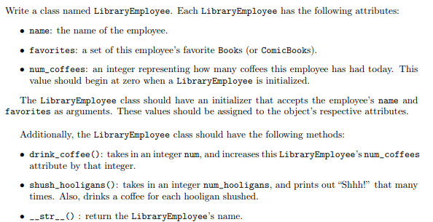
Question 1 – Classes (not from a midterm)
Copyright: Stanford
Notes:
This is a good one; use the wording from the Classes function on slide 6

Slide 4
OOP Recap
Class
A class can be thought of as a template for the objects that are instances of it.
Attributes
Data
Methods
Functions

Slide 5

OOP Recap
Turtle
Instances (objects) of the Turtle class.
name
x location
y location
name: Susmit
x location: 134
y location: 45
name: Lucy
x location: 24
y location: 35
move up
move down
move left
move right
go to
name: Brian
x location: 92
y location: 62

Slide 6
OOP Recap
class Name:
def __init__(self, param1, param2, …):
self.param1 = param1
self.param2 = param2
…
body
def method1(self, parameters):
body
def method2(self, parameters):
body
def method3(self, parameters):
body
General form of a Class:
Class Name
CamelCase
CourseGrades
BankAccount
FlightStatus
XRayImage
Constructor
Methods

Slide 7
OOP Recap
self
Reference to the instance of the class.
class Turtle:
def __init__(self, x, y):
self.x = x
self.y = y
def up(self):
self.y += 1
def goto(self, x, y):
self.x = x
self.y = y
def get_position(self):
return self.x, self.y

Slide 8
OOP Recap
Because at the time of designing the class we don’t know what these instance names will be, we just chose one.
self
class Turtle:
def __init__(self, x, y):
self.x = x
self.y = y
def up(self):
self.y += 1
def goto(self, x, y):
self.x = x
self.y = y
def get_position(self):
return self.x, self.y

Slide 9
OOP Recap
def my_func():
print(“Hello”)
my_func
Accessing attributes (Data) and methods (Functions) is different.
This function has not been called.
ben = Turtle(0, 0)
ben.x
ben.up()
Attribute.
A Method is a function, and we call functions using parentheses.

Slide 10
OOP Recap
seb = Turtle(0, 0)
class Turtle:
def __init__(self, x, y):
self.x = x
self.y = y
def up(self):
self.y += 1
def goto(self, x, y):
self.x = x
self.y = y
def get_position(self):
return self.x, self.y
These parameters are passed to the constructor (the __init__ method).

Slide 11
See Jupyter Notebook for the solution!

Slide 12
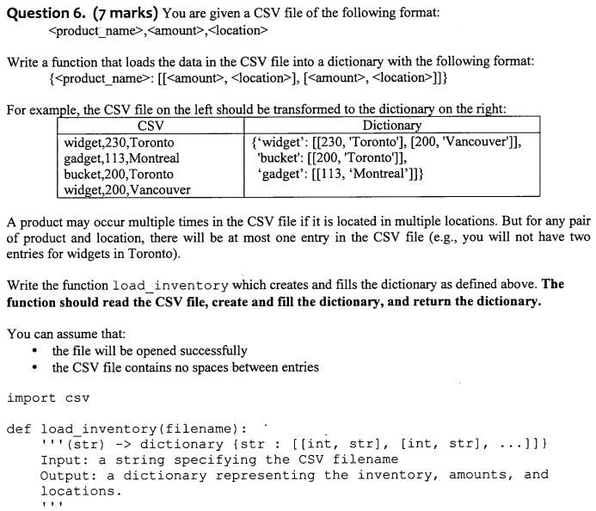
Question 2 – String manipulation & CSVs (modified from exam!)
CSV | Dictionary
widget,230,Toronto-Ontario gadget,113,Montreal-Quebec bucket,200,Toronto-Ontario widget,200,Vancouver-BC | {‘widget’: [[230, [‘Toronto’, ‘Ontario’]], [200, [‘Vancouver’, ‘BC’]]], ‘bucket’:[[200, [‘Toronto’, ‘Ontario’]]], ‘gadget’: [[113, [‘Montreal’, ‘Quebec’]]
Notes:
This one is better; split (Toronto-Ontario) and incorporate into this

Slide 13

Reading CSV Files
The CSV module is a powerful solution developed for working with CSV files.
Reading of CSV files is done using the CSV reader. You can construct a reader object using csv.reader() which takes the file object as input.
The reader object can be used to iterate through the contents of the CSV file, similarly to how a file object was used to iterate through the contents in a text file.

Slide 14
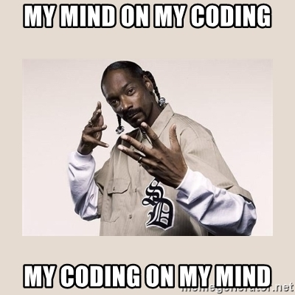
Example: Reading a CSV File (open)
Read each row of a CSV file using open
import csv
csvfile = open("grades.csv", "r")
grades_reader = csv.reader(csvfile)
row_num = 1
for row in grades_reader:
print('Row #', row_num, ':', row)
row_num += 1
csvfile.close()
Row # 1 : ['Name', 'Test1', 'Test2', 'Final']
Row # 2 : [‘Kendrick', '100', '50', '29']
Row # 3 : [‘Dre', '76', '32', '33']
Row # 4 : [‘Snoop', '25', '75', '95']

Slide 15
Example: Reading a CSV File (with)
Read each row of a CSV file using with
import csv
with open('grades.csv', 'r') as csvfile:
grades_reader = csv.reader(csvfile)
row_num = 1
for row in grades_reader:
print('Row #', row_num, ':', row)
row_num += 1
Row # 1 : ['Name', 'Test1', 'Test2', 'Final']
Row # 2 : [‘Kendrick', '100', '50', '29']
Row # 3 : [‘Dre', '76', '32', '33']
Row # 4 : [‘Snoop', '25', '75', '95']

Slide 16
Writing CSV Files
To write to the file we would first need to create a CSV writer object, csv.writer(), which similar to how we made a, CSV reader object.
Once the CSV writer object is created, we can use the writerow() method to populate it with data.
The writerow()method can only write a single row to the file at a time.

Slide 17
Example: CSV Files
In the previous grade example there were a few marking errors on the final exam and both John and Mark should have received a higher grade. Update the grades using the CSV writerow()method.
import csv
grades = [['Name', 'Test1', 'Test2', 'Final'],
[‘Kendrick', '100', '50', '69'],
[‘Dre', '76', '32', '53'],
[‘Snoop', '25', '75', '95']]
with open('grades_new.csv', 'w') as csvfile:
grades_writer = csv.writer(csvfile)
for row in grades:
grades_writer.writerow(row)

Slide 18
See Jupyter Notebook for the solution!

Slide 19
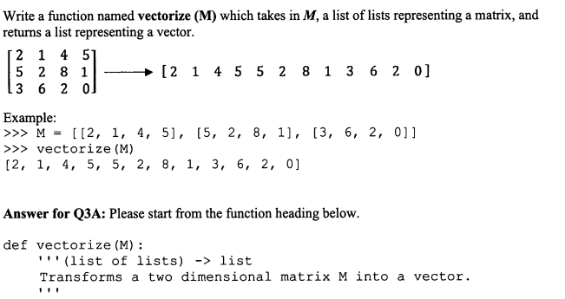
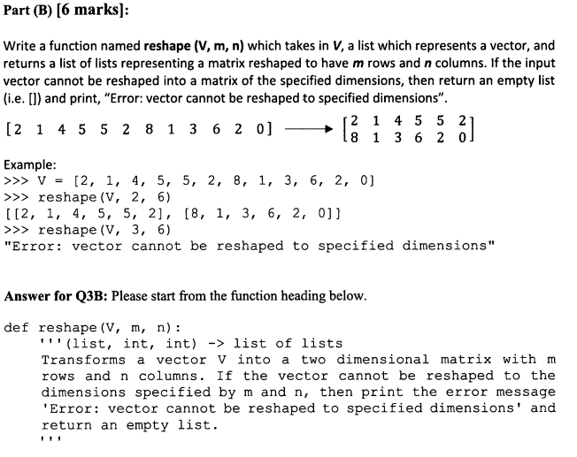
Question 3 (if time)

Slide 20
See Jupyter Notebook for the solution!

